Slide 1
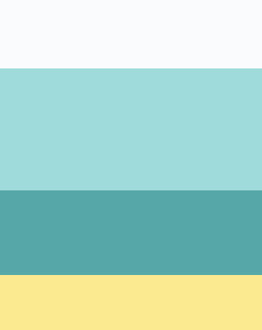
Kinetic
Typography

